Slide 1
recommendation based on reviews
File created on: 7/12/2019 7:06:27 PM

Slide 2


Slide 3
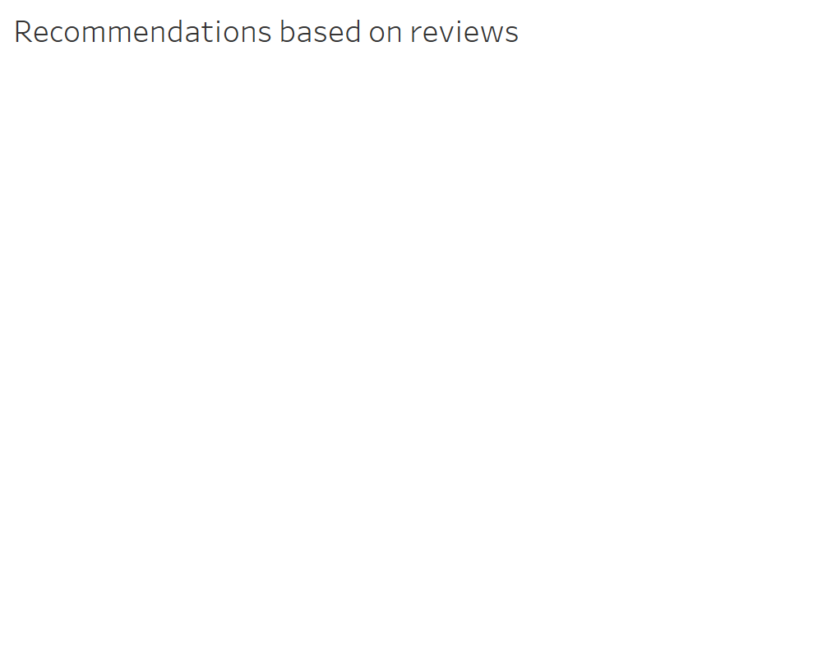

Slide 4
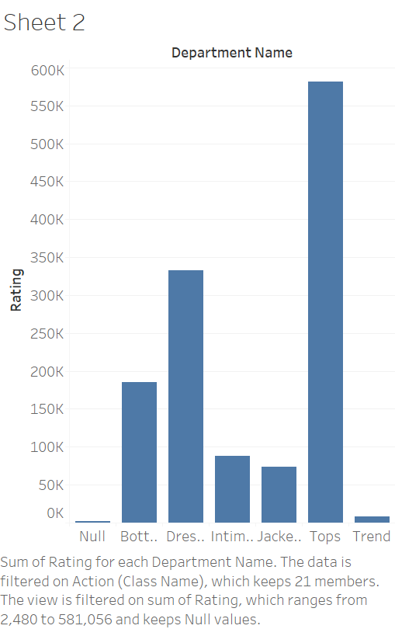

Slide 5
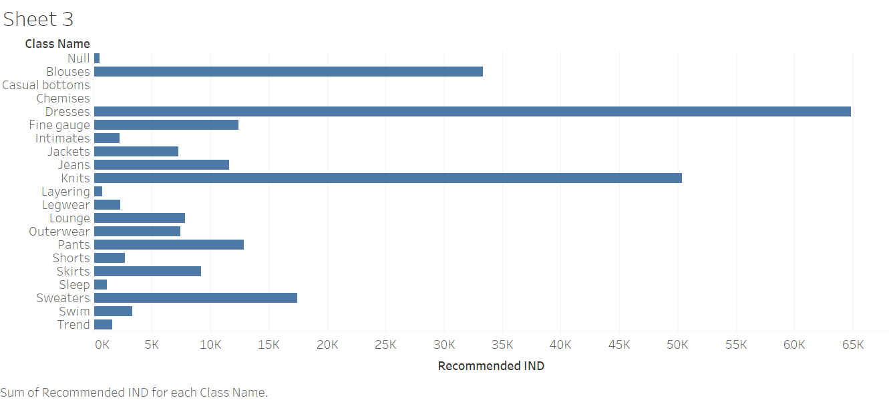

Slide 6


Slide 7
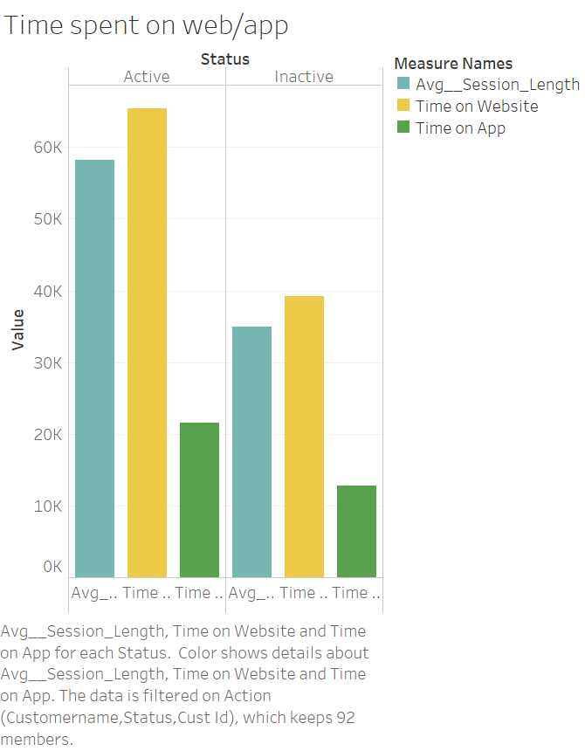

Slide 8
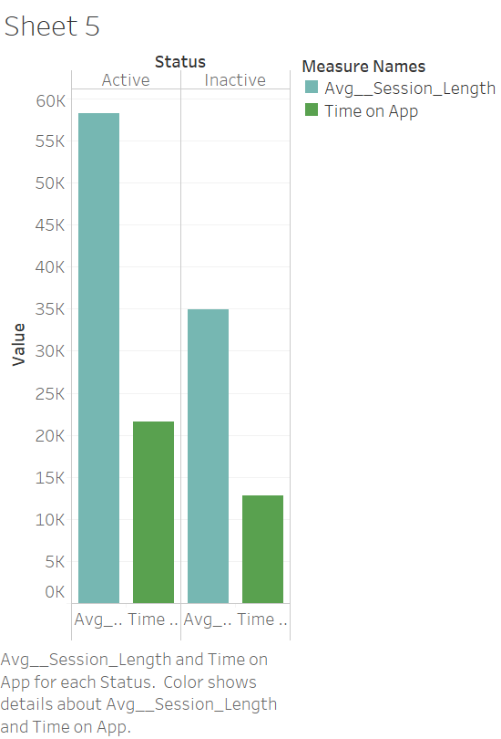

Slide 9
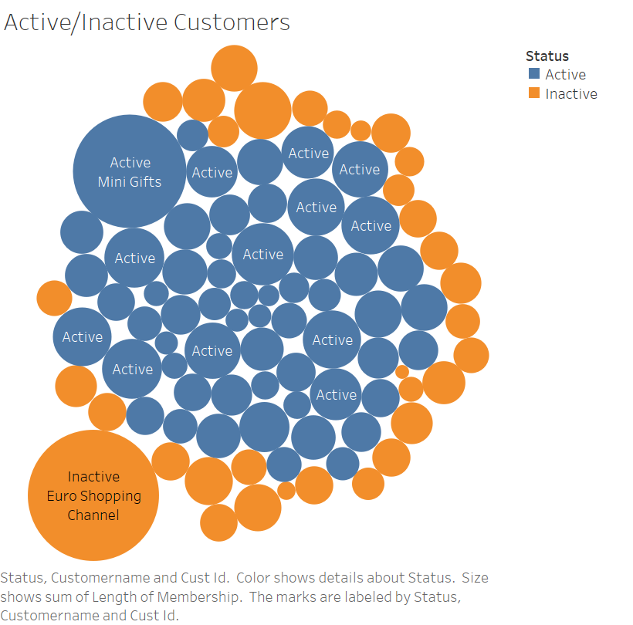

Slide 10
